Slide 1
UI-19 Employer Declaration & Stats SA Quarterly Employment Statistics (QES) Survey
Session 51
Presented by Vikesh Ravjee

Slide 2
DISCLAIMER
This presentation is only a summary of some of Adapt IT’s products, features and their latest developments. Adapt IT only intends for the information to give you an overview, and not a complete and comprehensive statement that necessarily suits your purposes.
Adapt IT reserves the right to change any information contained in this presentation and is not responsible for any loss that results from inaccuracies in the information. You may not distribute or reproduce the information without Adapt IT’s written permission.

Slide 3
UI-19 Employer Declaration
UI-19 Form – Employer
UI-19 Form – Employee
Salary Schedule Form
Statistics SA - Quarterly Employment Statistics (QES) Survey
QES – Employment
QES – Earnings
QES – Activity
QES – General Information
QES – Comments
Table of contents

Slide 4
UI-19 – Employer Declaration

Slide 5
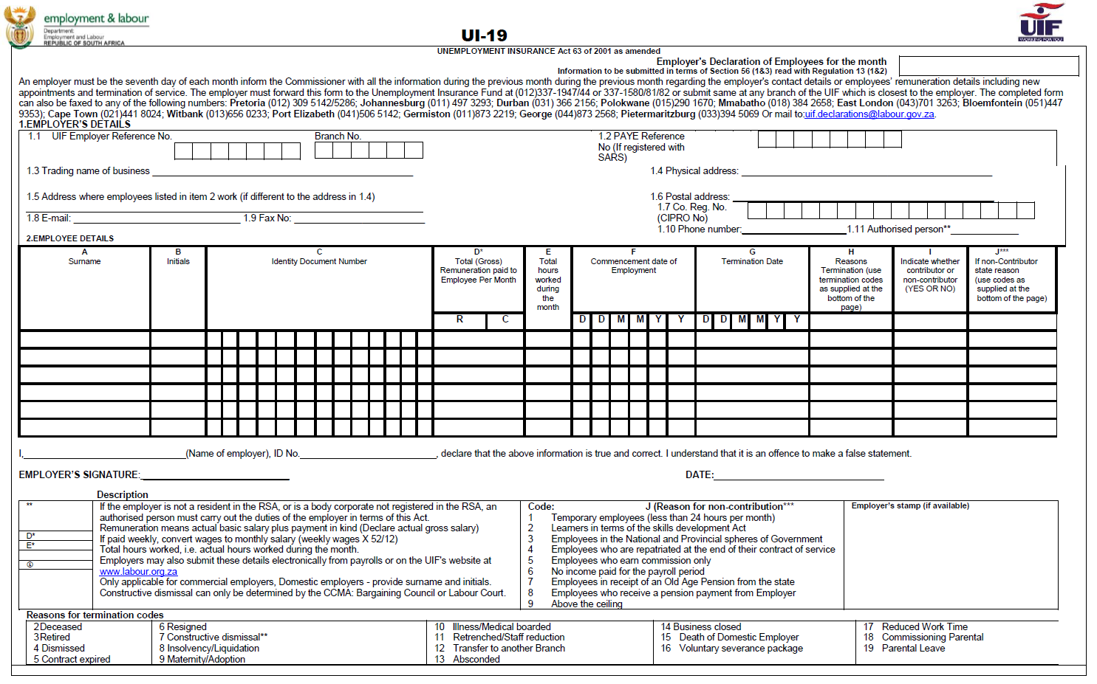
UI-19 – Employer Declaration Form
The UI-19 certificate is a crucial requirement for any unemployed person to enable them to claim benefits from the UIF.
Resignation
Termination
Retrenchment
Employee still in service but not working/earning a salary E.g. Unpaid Leave, Sabbatical

Slide 6
UI-19 – Employer Declaration Form

Slide 7
UI-19 – Employer Details

Slide 8
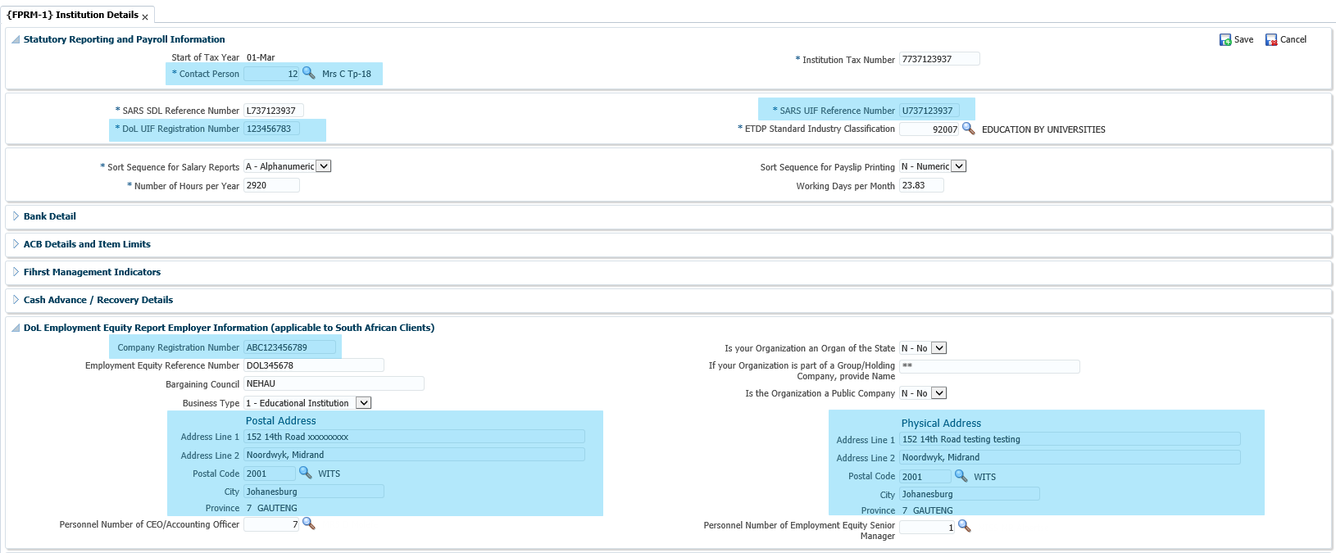
UI-19 – Employer Details (FPRM-1 – Institution Details

Slide 9
UI-19 – Employer Declaration Form

Slide 10
UI-19 – Employee Details

Slide 11
UI-19 – Employee Details (PBOP-1 – Personnel Biographical)

Slide 12
UI-19 – Employee Details

Slide 13
UI-19 – Employee Details (PBOP-2 – Personnel Service Records)

Slide 14
UI-19 – Employer Declaration Form

Slide 15
UI-19 – Employee Declaration Form

Slide 16
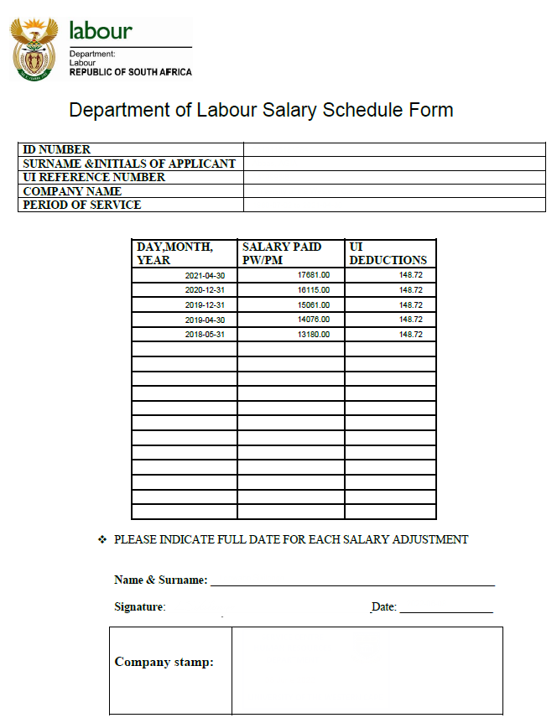
UI-19 – Salary Schedule Form

Slide 17
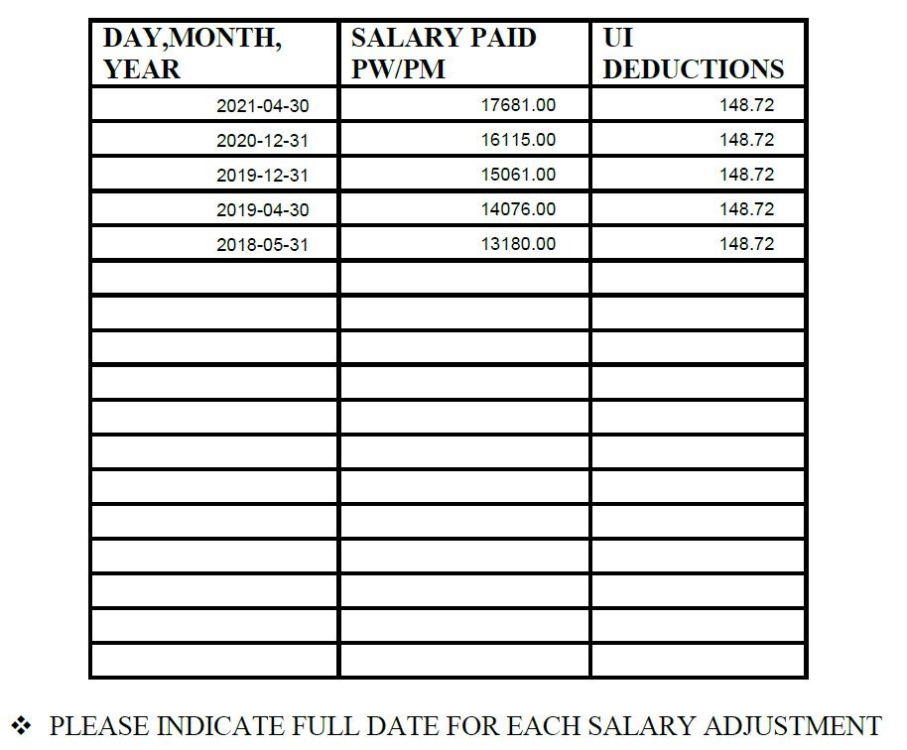
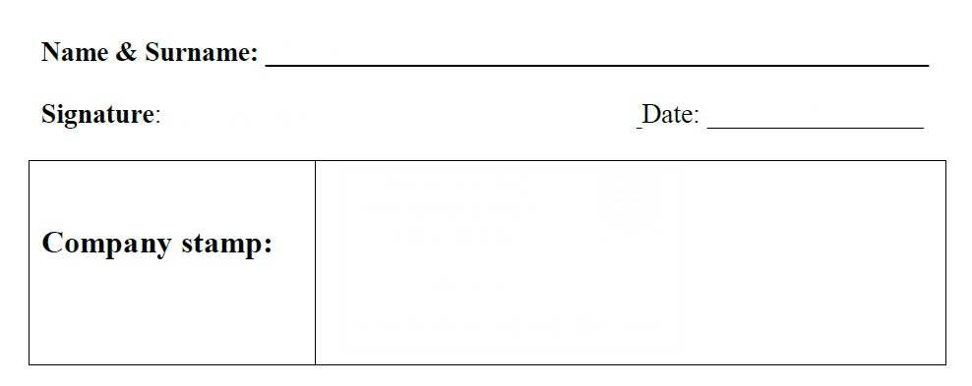
UI-19 – Salary Schedule Form
HR Business Partner
11-Mar-2025

Slide 18
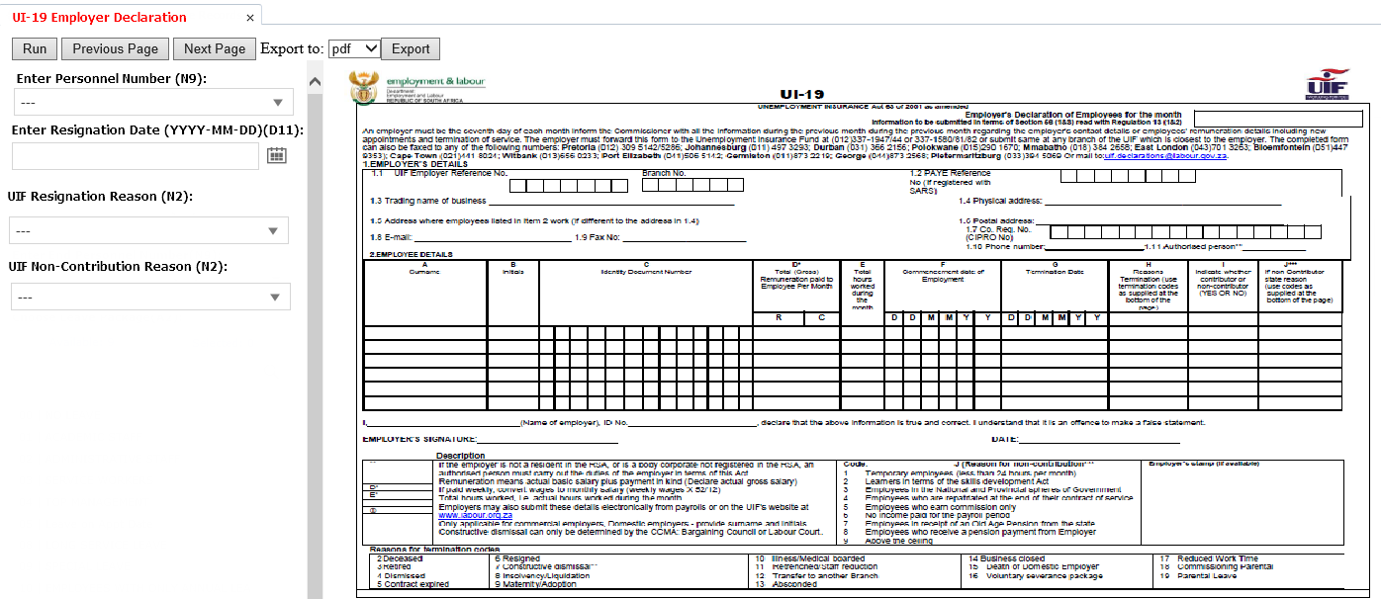
Jasper Report Concept

Slide 19
Stats SA Quarterly Employment Statistics (QES) Survey

Slide 20
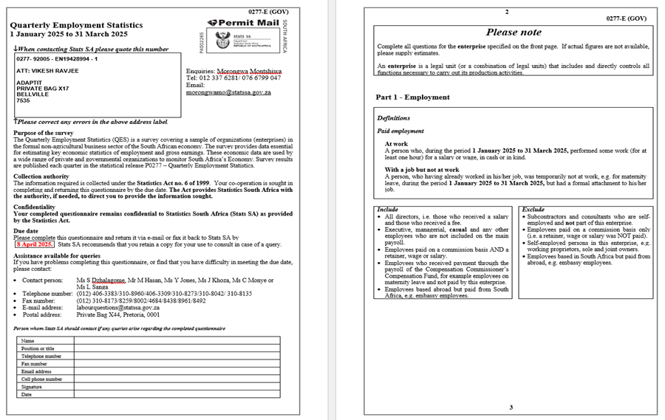
Stats SA – Quarterly Employment Statistics (QES) Survey
The Quarterly Employment Statistics (QES) is a survey covering a sample of organizations (enterprises) in the formal non-agricultural business sector of the South African economy.
The survey provides data essential for estimating key economic statistics of employment and gross earnings.
These economic data are used by a wide range of private and governmental organizations to monitor South Africa’s Economy.
Survey results are published each quarter in the statistical release P0277 – Quarterly Employment Statistics.

Slide 21
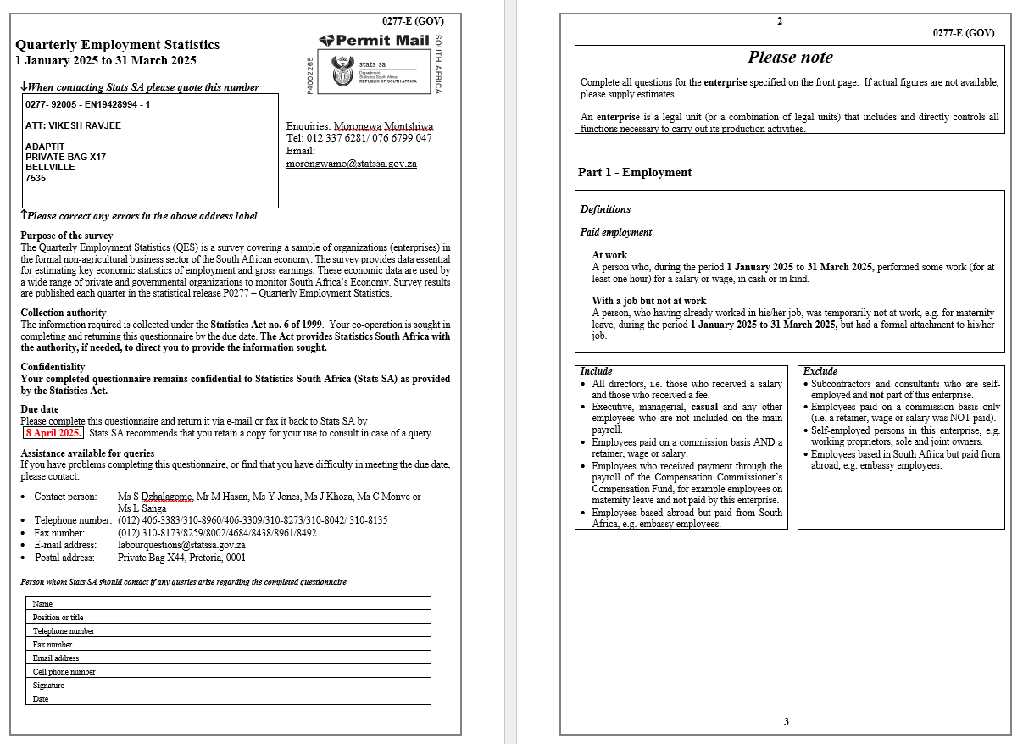
Stats SA – Quarterly Employment Statistics (QES) Survey

Slide 22
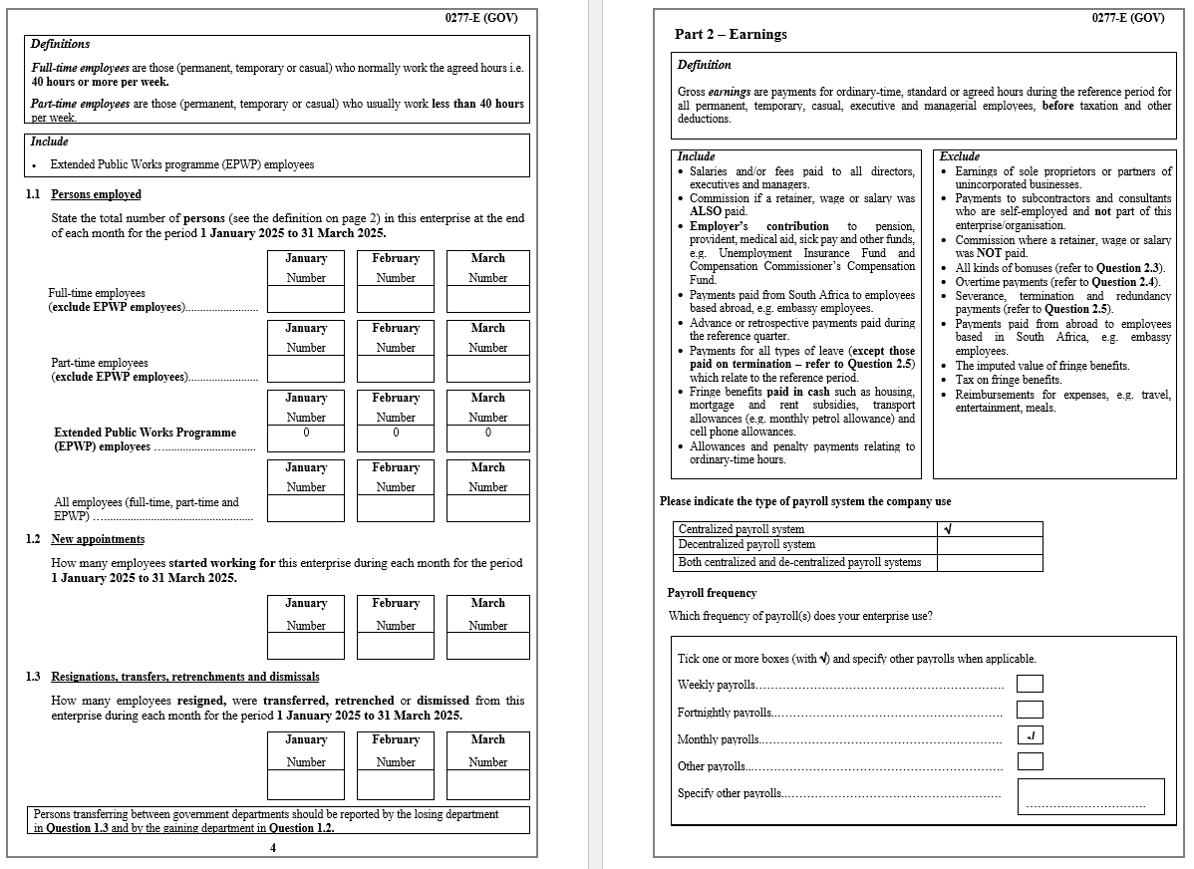
Stats SA – Quarterly Employment Statistics (QES) Survey

Slide 23
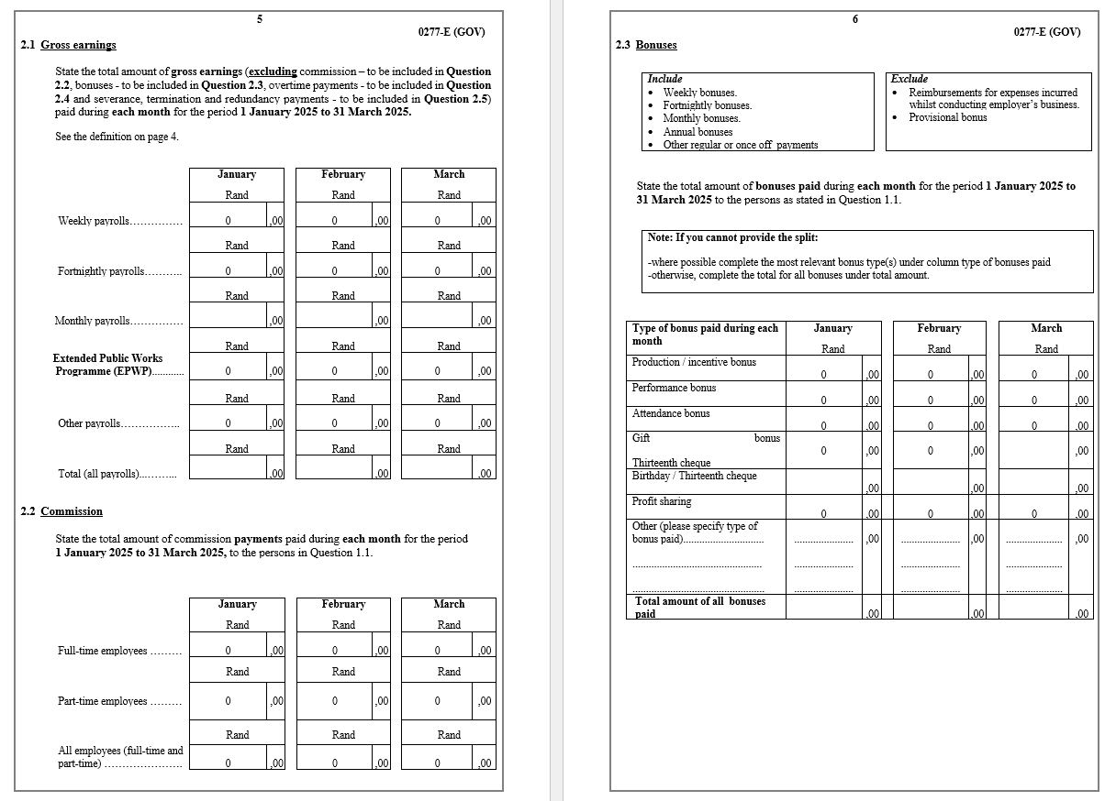
Stats SA – Quarterly Employment Statistics (QES) Survey

Slide 24
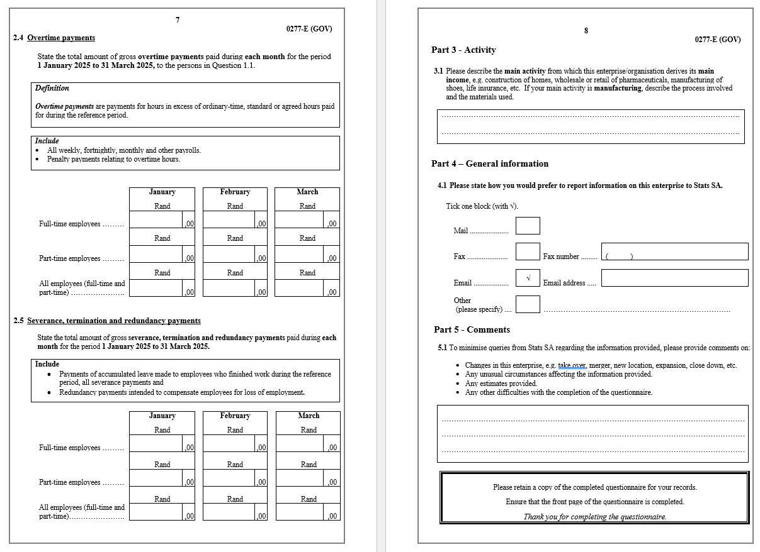
Stats SA – Quarterly Employment Statistics (QES) Survey

Slide 25
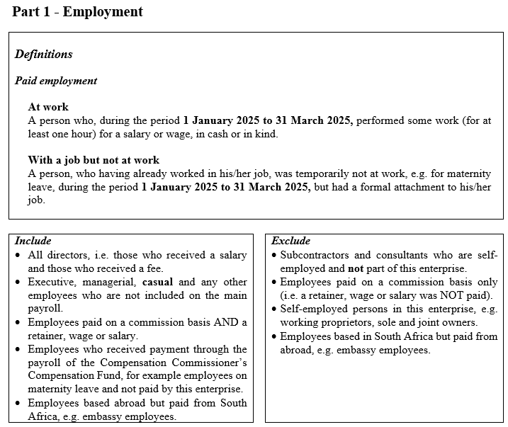
Stats SA QES – Employment

Slide 26
Stats SA QES – Employment
Full-time employees are those (permanent, temporary or casual) who normally work the agreed hours i.e. 40 hours or more per week.
Part-time employees are those (permanent, temporary or casual) who usually work less than 40 hours per week.
Extended Public Works programme (EPWP) employees

Slide 27
Stats SA QES – Employment (Persons Employed)

Slide 28
Stats SA QES – Employment (New Appointments)
Stats SA QES – Employment (Resignations, Transfers,
Retrenchments and Dismissals

Slide 29
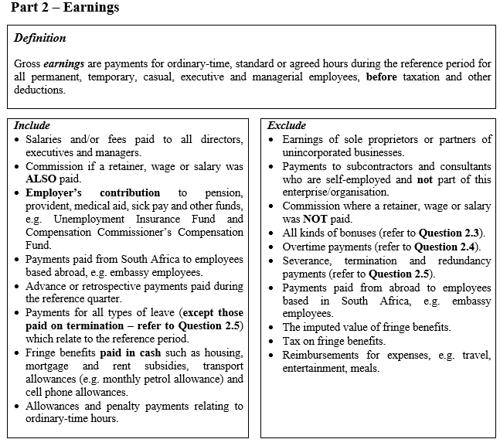
Stats SA QES – Earnings

Slide 30
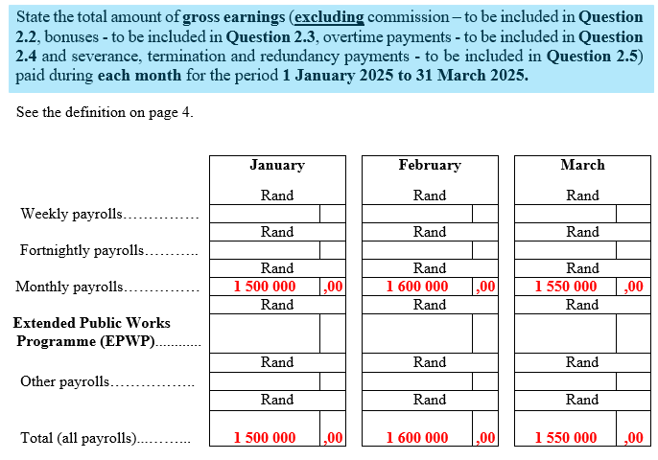
Stats SA QES – Earnings (Gross Earnings)

Slide 31
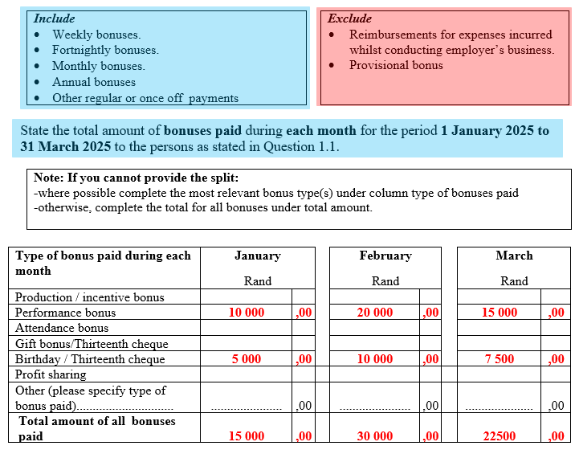
Stats SA QES – Earnings (Bonuses)

Slide 32
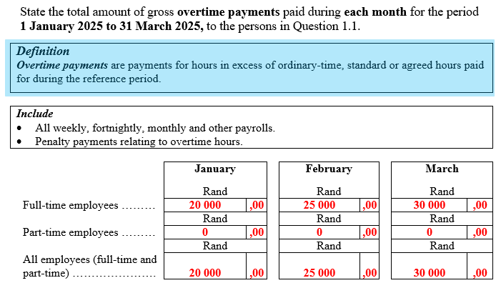
Stats SA QES – Earnings (Overtime Payments)

Slide 33
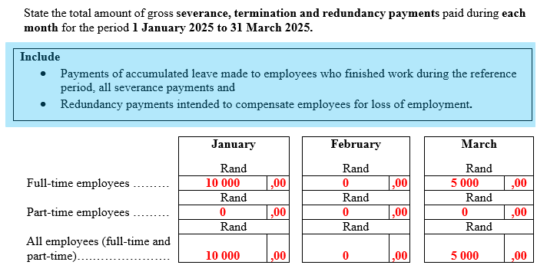
Stats SA QES – Earnings (Severance, Termination & Redundancy Payments)

Slide 34
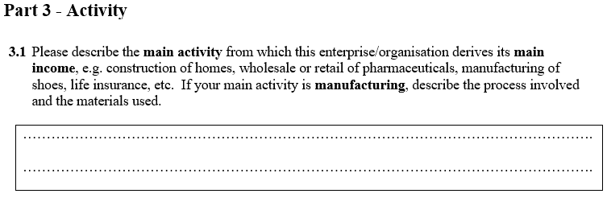
Stats SA QES – Activity

Slide 35
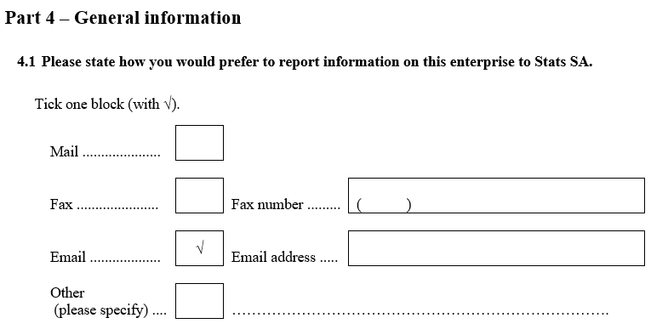
Stats SA QES – General Information

Slide 36
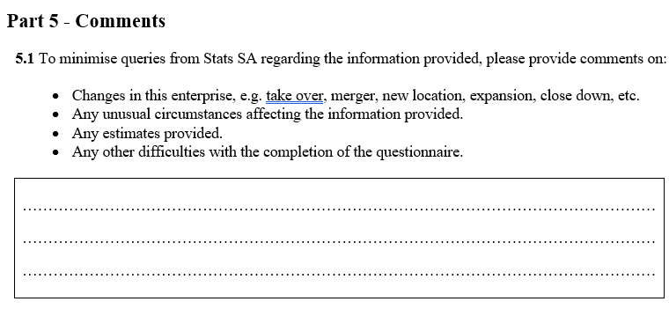
Stats SA QES – Comments

Slide 37
DISCLAIMER
This presentation is only a summary of some of Adapt IT’s products, features and their latest developments. Adapt IT only intends for the information to give you an overview, and not a complete and comprehensive statement that necessarily suits your purposes.
Adapt IT reserves the right to change any information contained in this presentation and is not responsible for any loss that results from inaccuracies in the information. You may not distribute or reproduce the information without Adapt IT’s written permission.

